Slide 1
Alcohols, phenols and ethers
Chapter 14

Slide 2
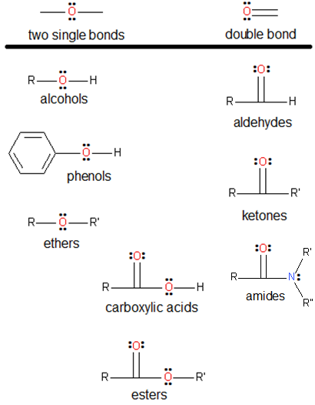

Bonding for oxygen atoms in organic compounds
Oxygen is commonly found in two forms in organic compounds:
Oxygen is group 6A
Needs to form two bonds
to get an octet.

Slide 3
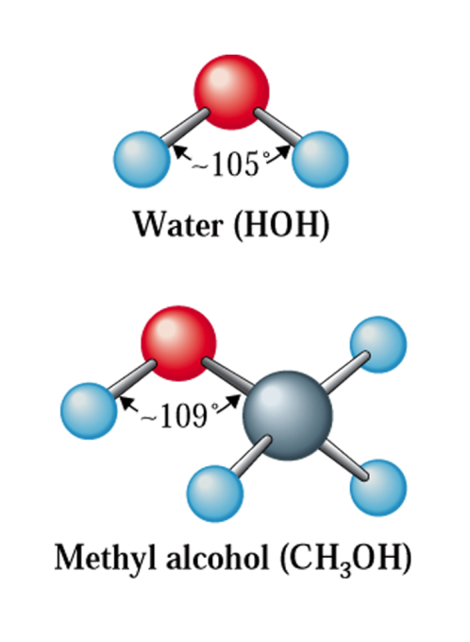
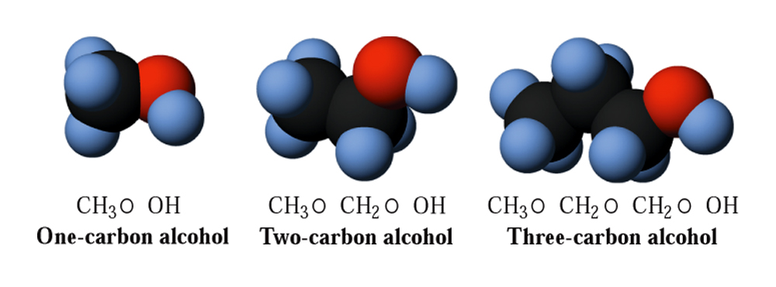
Structural characteristics of alcohols
Alcohols have the general formula:
R-OH
where “R” involves a saturated C-atom (bound to hydrogens and/or other carbons).
For example:

Slide 4
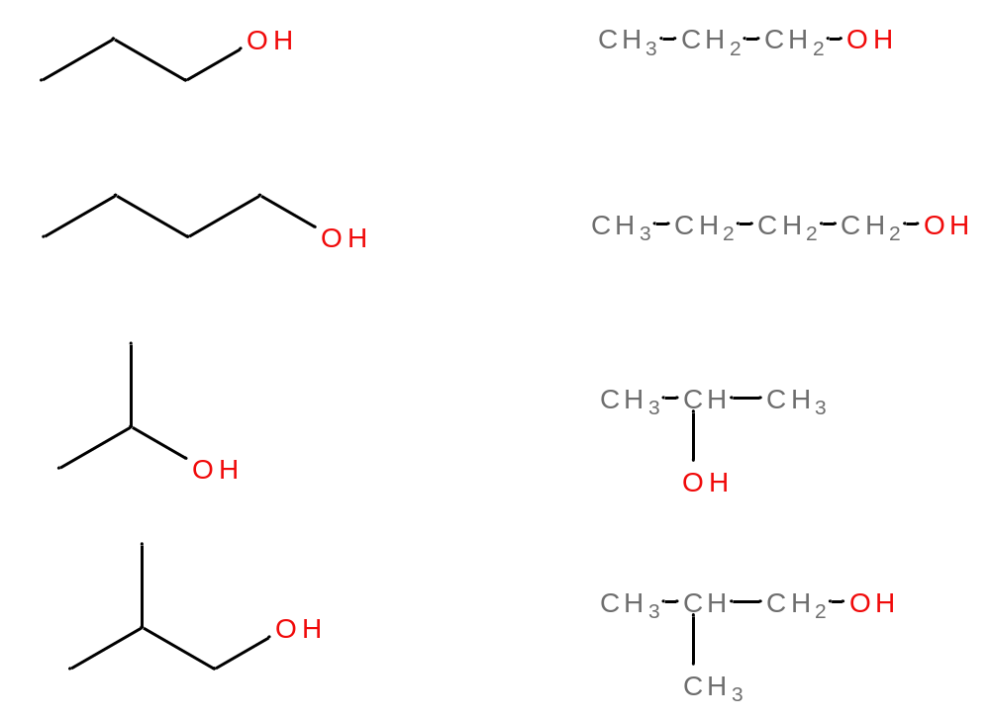
Structural characteristics of alcohols
Condensed structural formulas or line-angle structures are commonly used for depicting alcohols
IUPAC name
1-Propanol
1-Butanol
2-Propanol
2-Methyl-1-propanol
(Isobutanol)

Slide 5
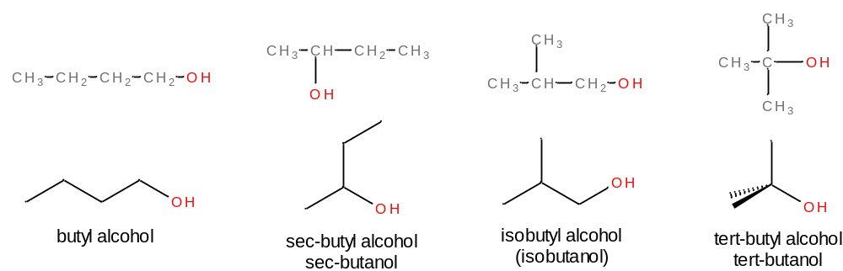
Nomenclature for alcohols
Common names for alcohols
Name the C-atoms of a single alkyl group as for alkanes.
Add the word “alcohol” following a space after the alkyl name.

Slide 6
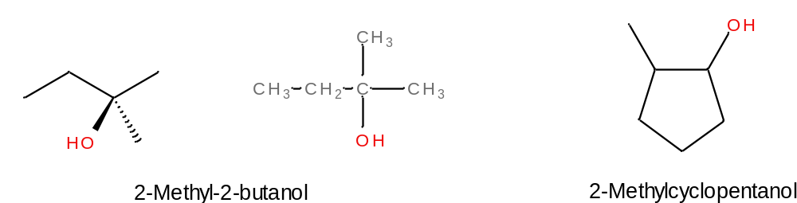
Nomenclature for alcohols
IUPAC Naming
Find longest, continuous C-chain to which the OH group (hydroxyl) is bound. Number the chain in a way that gives the OH group the lowest numbering.
Name and number other substituents present.
The name for the corresponding alkane chain (e.g. for a 6-C chain, hexane) loses the “e” and picks up “ol” (hexanol).
For cyclic alcohols, the OH group is understood to be attached to C-1.

Slide 7
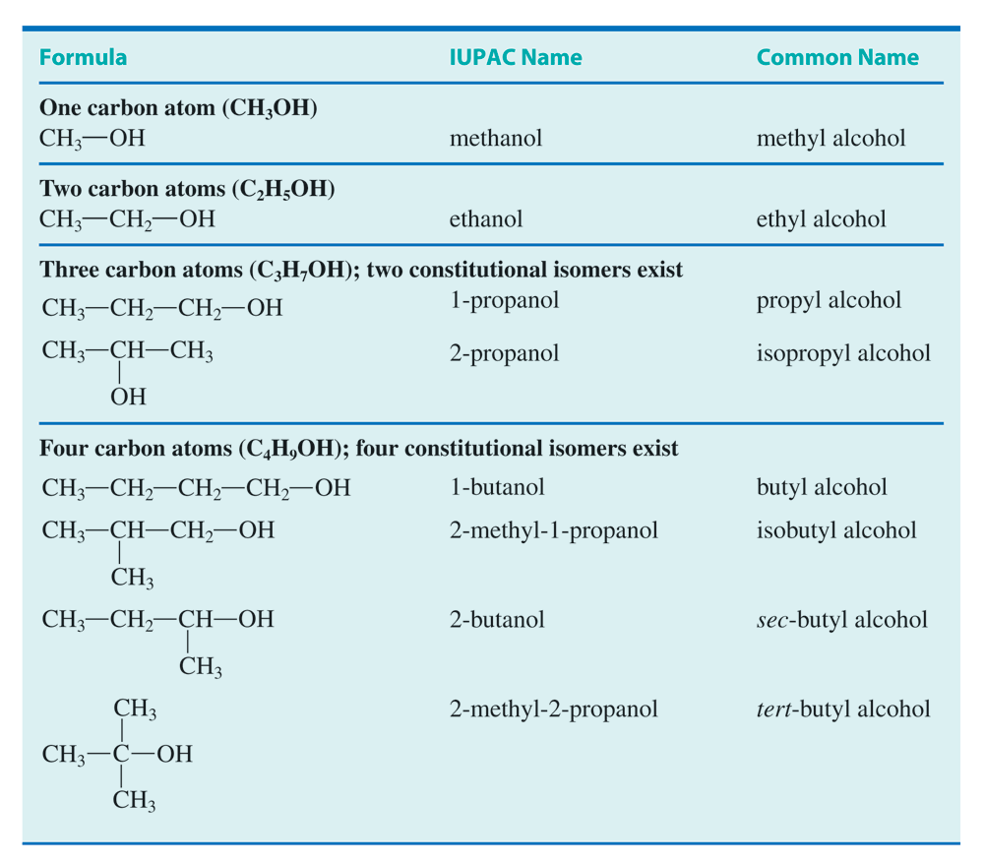

Slide 8
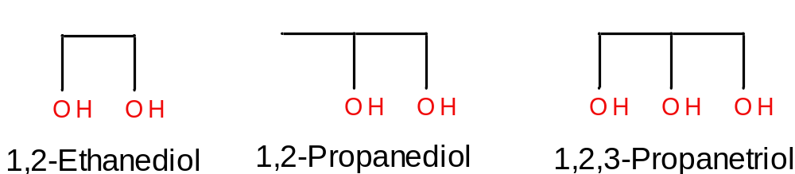
Alcohols with more than one OH group
Polyhydroxyl alcohols possess more than one OH group.
Alcohols which possess two OH groups are called “diols” and those with three OH groups are called “triols”
Alkane name + diol, “triol”, etc.

Slide 9
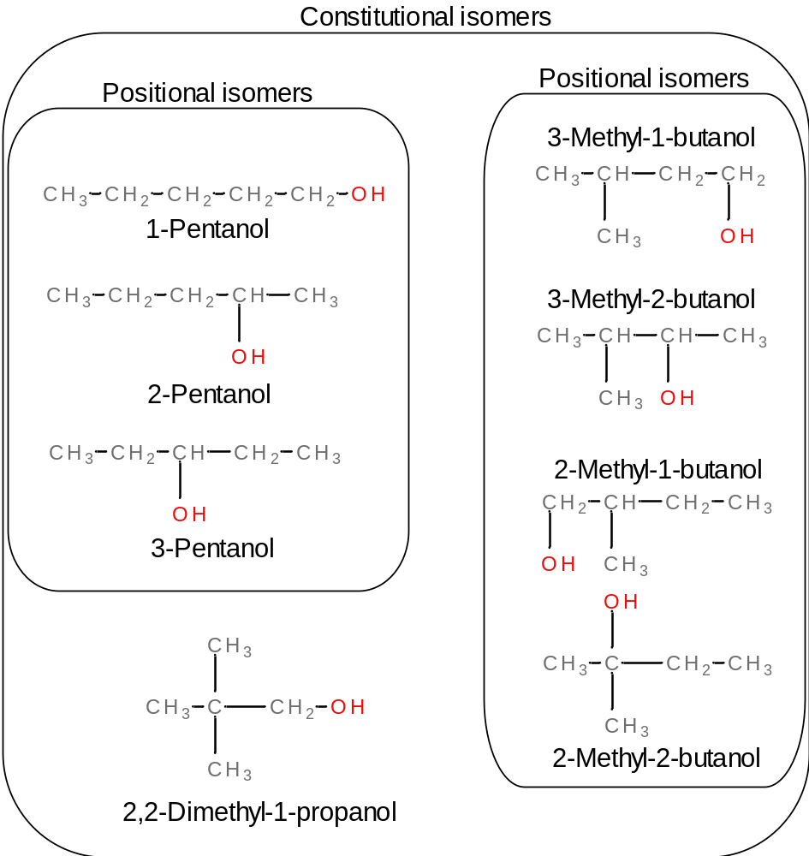
Isomerism for alcohols

Slide 10
Commonly encountered alcohols
You’ve probably used a few of the following alcohols:
  Methyl and ethyl alcohol
  Isopropyl alcohol
  Ethylene glycol (1,2-Ethane diol)
  Propylene glycol (1,2-Propane diol)
  Glycerol (1,2,3-Propane triol)

Slide 11
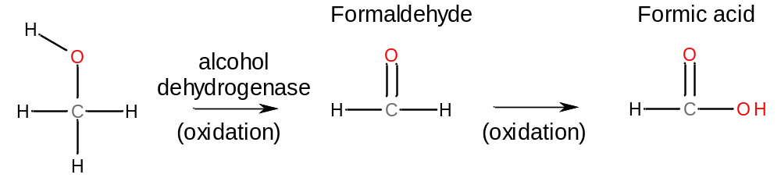
Commonly encountered alcohols
Methanol (CH₃OH) finds use as a solvent in chemical reactions and in fuel for high-performance combustion engines.
Drinking methanol is a no-no. It is metabolized to formaldehyde and formic acid by the liver (alcohol dehydrogenase):

Slide 12
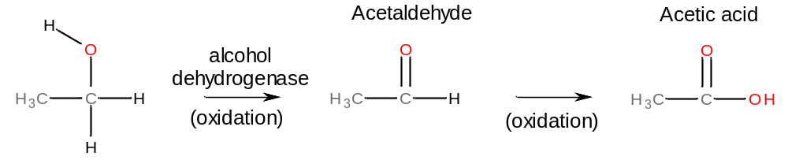
Commonly encountered alcohols
Ethanol (CH₃CH₂OH) is also metabolized by the body, and this reaction produces acetaldehyde and acetic acid:
Excessive drinking leads to liver cirrhosis, physiological addiction, loss of memory. Drinking during pregnancy poses risks for birth defects.
Ethanol is sometimes rendered undrinkable by the addition of small quantities of toxic substances (e.g. benzene).
Industrially, ethanol is synthesized by hydration of ethene.

Slide 13
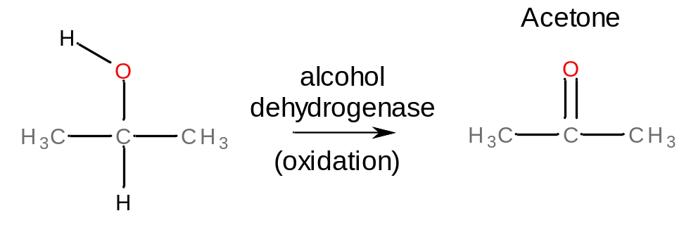
Commonly encountered alcohols
Isopropyl alcohol is used in rubbing alcohol (70% isopropyl alcohol in H₂O) and in cosmetics.
Ingested, isopropyl alcohol is metabolized to acetone:

Slide 14
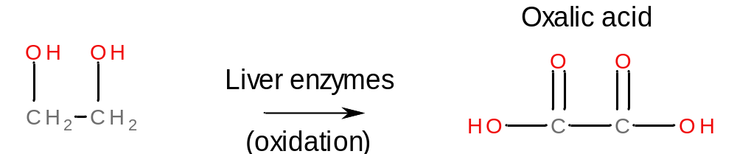
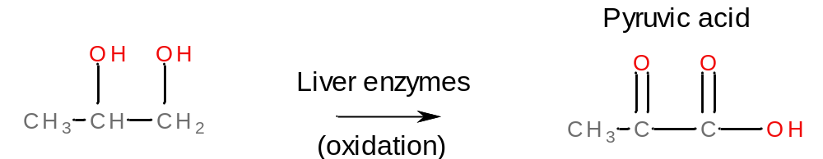
Commonly encountered alcohols
Ethylene glycol and propylene glycol are colorless and odorless and very water-soluble. Used as anti-freeze and reactants for the synthesis in polyesters.
When ingested, ethylene glycol is metabolized to oxalic acid, which causes renal problems:
Propylene glycol is metabolized to pyruvic acid, which is non-toxic:

Slide 15
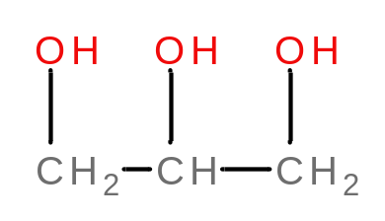
Commonly encountered alcohols
Gycerol is a thick liquid that is normally present in the body (it is a product of fat metabolism).
Because of its affinity for water, it is often added to pharmaceutical preparations such as skin lotions and soap, and for shaving cream and glycerol suppositories.

Slide 16
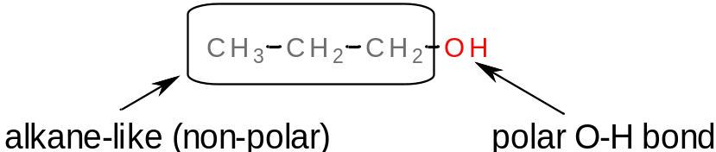
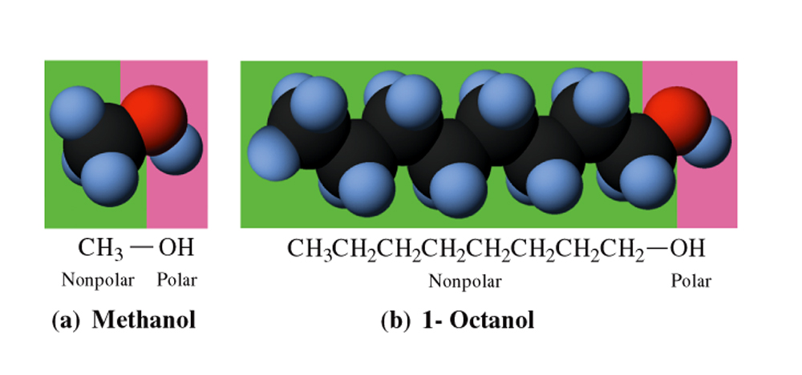
Physical properties of alcohols
Alcohols consist of:
  a non-polar (alkane-like) chain
  a polar hydroxyl group
  Thus, alcohols might be water-soluble, or not (depending on the length of the carbon chain).
We already saw that the boiling points of alkanes increase with increasing chain length. The same is true for alcohols.
Alcohols with more than one hydroxyl group (polyhydroxy alcohols) have higher boiling points than monoydroxy alcohols.
Boiling points
Ethane: -89ºC
Methanol: 65ºC
Ethanol: 78ºC
1,2-Ethane diol: 197ºC
London forces
London + H-bonding
London + H-bonding
London + more
H-bonding

Slide 17
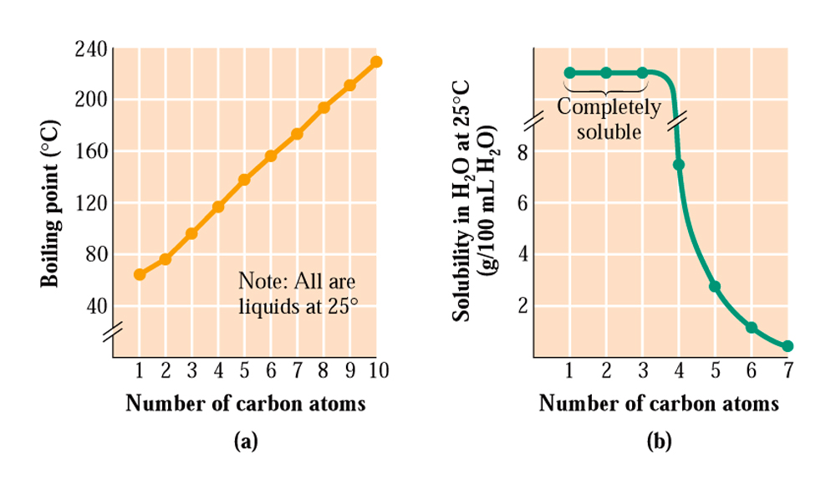
Physical properties of alcohols
The water-solubility of alcohols depends on the length of the alkyl chain in the alcohol.
Monohydroxy alcohols having chains longer than three carbons are not very water-soluble.
Polyhydroxy alcohols are more soluble because they have more opportunities for hydrogen-bonding with water.

Slide 18
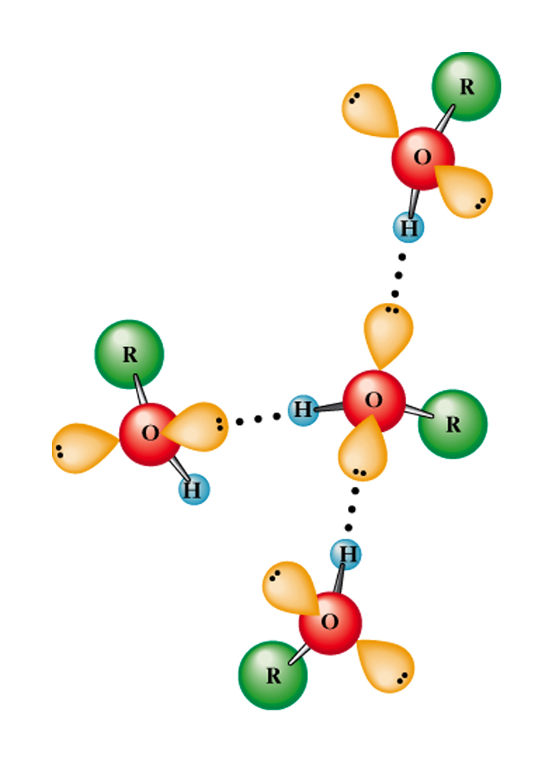
Physical properties of alcohols
Alcohols have higher boiling points than alkanes of the same chain length (because they hydrogen bond to each other; the intermolecular forces for alkanes are only London forces)
Alcohols of a given chain length are far more water-soluble than alkanes.
Remember: H-bonding is the strongest intermolecular force.
London forces are weak by comparison.

Slide 19
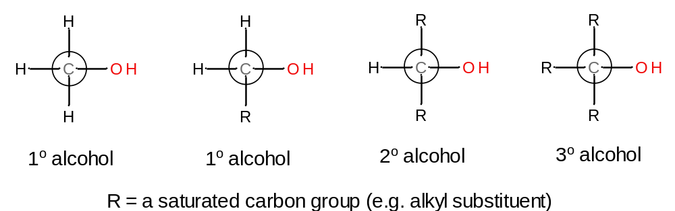
Classification of alcohols
Alcohols may be classified as 1º, 2º, or 3º, by considering the number of carbons bound to the hydroxy-bearing carbon.
Although alcohols are able to H-bond, their ability to do so becomes impaired by other carbon atoms near the hydroxy group. The more carbon groups that are bound to the hydroxy-bearing carbon, the more they get in the way of H-bonding (steric hindrance).

Slide 20
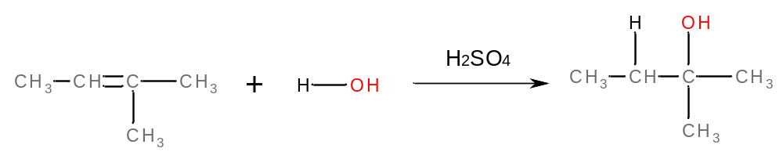
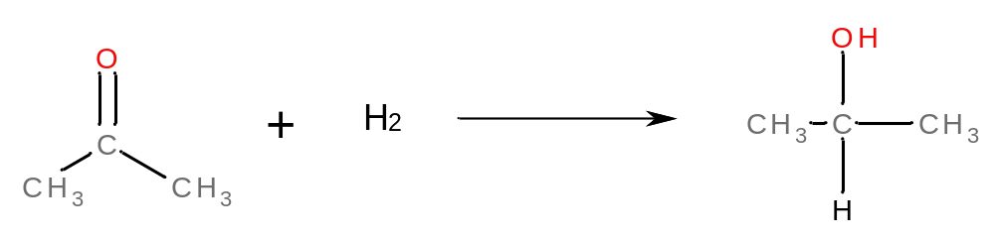
Preparation of alcohols
Alcohols can be prepared by hydration of alkenes (as we saw in Chapter-13):
They can also be prepared by the hydrogenation of C-O double bonds:
(Hydrogenation of this double bond is equivalent to a reduction in organic chemistry)

Slide 21
Chemical reactions of alcohols
Combustion – makes CO₂ and H₂O
Dehydration (loss of water – intramolecular) – make an alkene
Dehydration (loss of water – intermolecular) – makes an ether
Oxidation – makes a carboxylic acid
Halogenation – makes a halogenated alkane

Slide 22
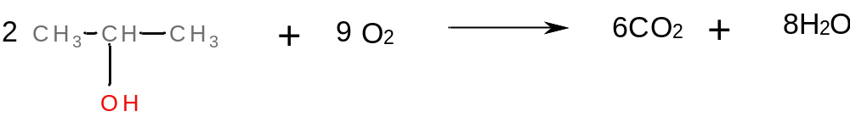
Chemical reactions of alcohols
Combustion reactions
Any organic molecule can undergo a combustion reaction. In combustion reactions involving alcohols, CO₂ and H₂O are produced:
  CH₃OH + O₂ → CO₂ + 2H₂O
  CH₃CH₂OH + O₂ → 2CO₂ + 3H₂O
  Or, for 2-Propanol:

Slide 23
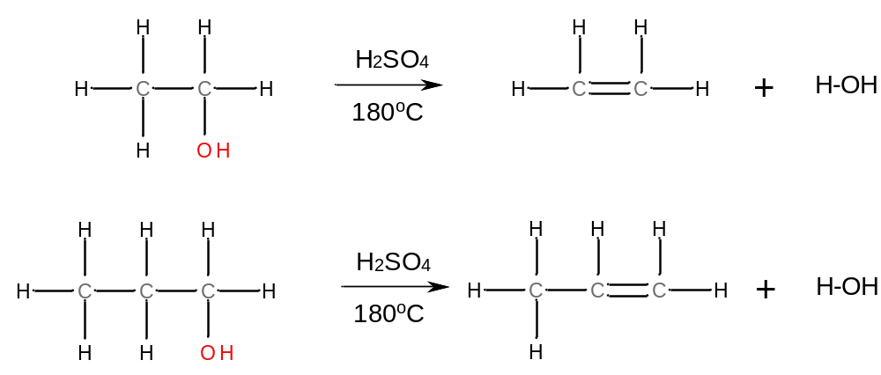
Chemical reactions of alcohols
Elimination reactions
In an intramolecular alcohol dehydration, a water molecule is lost (eliminated) from a single alcohol molecule.
The elimination involved loss of the OH group and a H-atom from an adjacent C-atom (sometimes, there’s more than one of these)

Slide 24

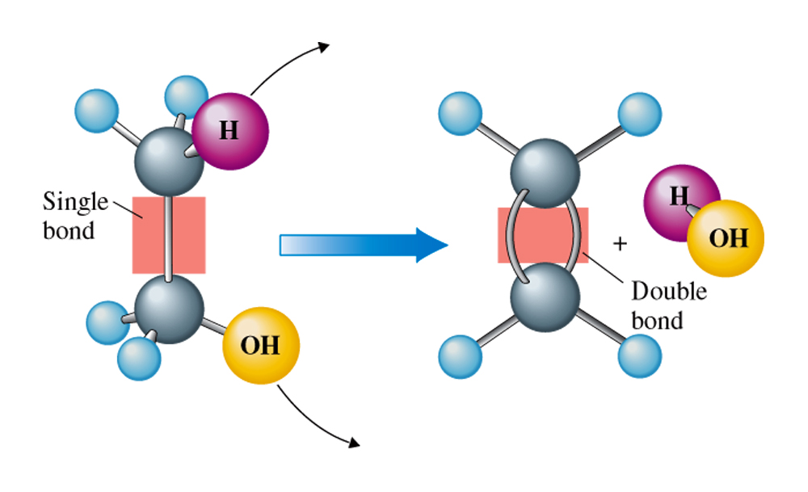
Chemical reactions of alcohols
Elimination reactions

Slide 25
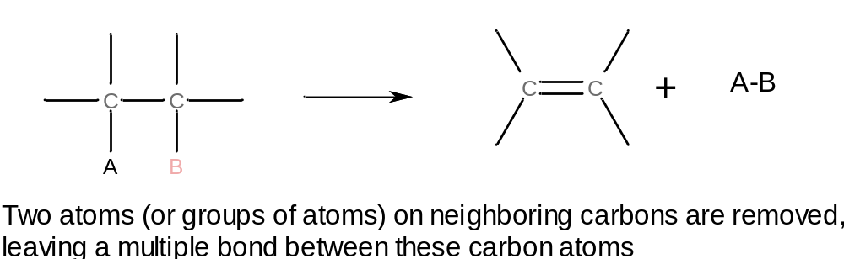
Chemical reactions of alcohols
Elimination reactions
In general, these kinds of reactions (eliminations) proceed as follows:

Slide 26
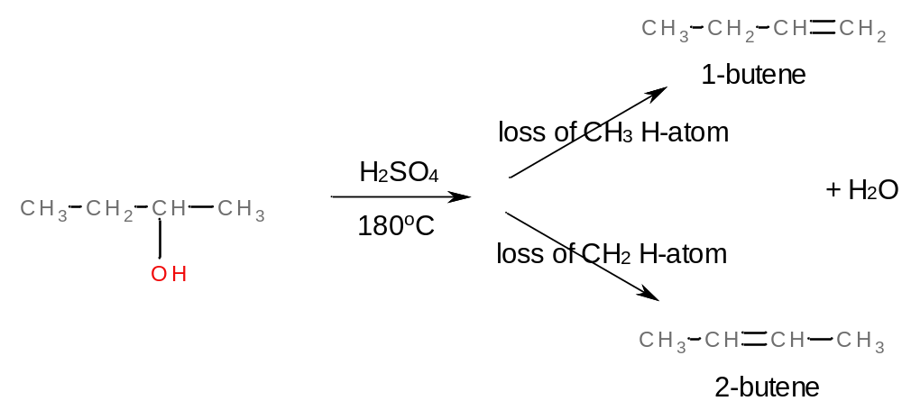
Chemical reactions of alcohols
Elimination reactions
If there is more than one adjacent carbon atom from which loss of a H-atom can occur, there will be more than one possible alkene dehydration product:
Use Zaitsev’s Rule to predict which alkene will be produced in the greater amount

Slide 27
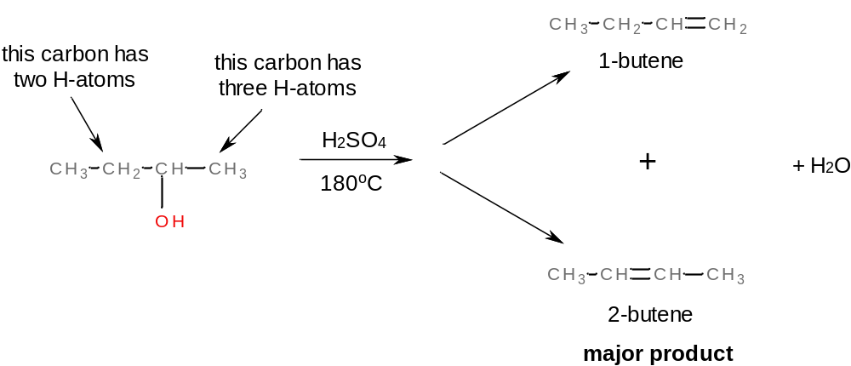
Chemical reactions of alcohols
Elimination reactions
Zaitsev’s Rule (for alcohol dehydrations): for cases where more than one alkene product might be formed from an elimination reaction, the hydrogen atom tends to be removed from the carbon that already possesses the fewest hydrogens.

Slide 28
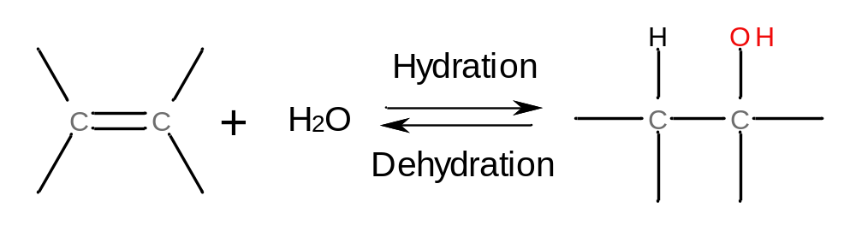
Chemical reactions of alcohols
Elimination reactions
The alcohol dehydration reaction (like all chemical reactions) is an equilibrium. Since it occurs through elimination of an H₂O molecule, conditions that favor H₂O loss (dry conditions (concentrated H₂SO₄), high temperatures) favor alkene formation.
On the other hand, if this reaction were run in dilute H₂SO₄, alcohol formation would be favored.

Slide 29
Chemical reactions of alcohols
Condensation reactions
When lower temperatures are used than those that yield alkenes, intermolecular loss of water tends to occur (involving two alcohol molecules) to produce ethers:
Dimethyl ether
A condensation reaction is a reaction in which two molecules combine to form
a larger molecule while liberating a small molecule like water.

Slide 30
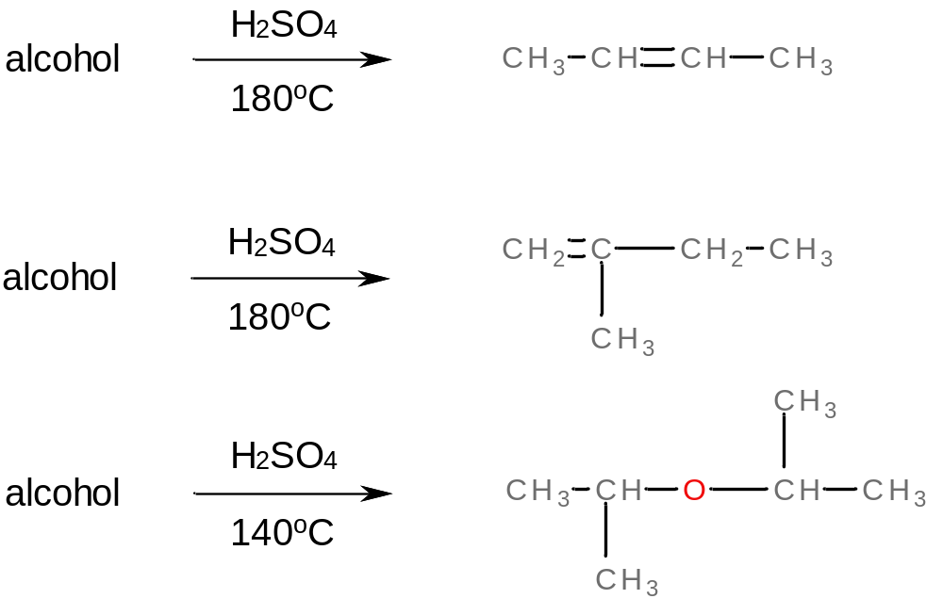
Chemical reactions of alcohols
Example 14.3, pg. 414: identify the alcohol needed to produce each of the following alcohol dehydration products:

Slide 31
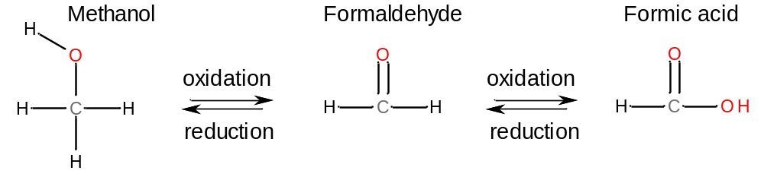
Chemical reactions of alcohols
Oxidation reactions
Oxidation/reduction reactions involving organic compounds result in a change in the number of H-atoms and/or the number of O-atoms bound to carbons in the molecule:
  Oxidations increase the number of C-O bonds and/or decrease the number of C-H bonds in a molecule.
  Reductions decrease the number of C-O bonds and/or increase the number of C-H bonds in a molecule.

Slide 32
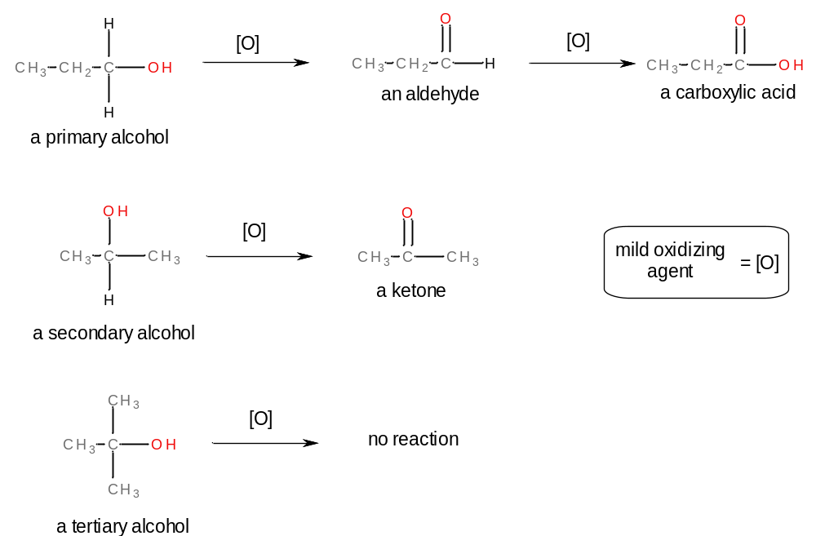
Chemical reactions of alcohols
Oxidation reactions
Primary and secondary alcohols can be oxidized by mild oxidizing agents to produce compounds with C-O double bonds (aldehydes, ketones, carboxylic acids).
No H on OH-bearing
carbon to remove here.

Slide 33
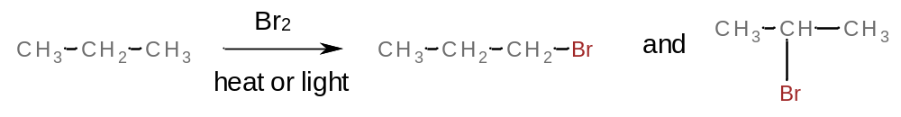
Chemical reactions of alcohols
Halogenation reactions
Alcohols undergo halogenation when reacted with trihalophosphines:
3R-OH + PX₃ → 3R-X + P(OH)₃
This reaction is more selective than the substitution reaction we saw in Ch-12 for forming halogenated alkanes from alkanes, because the halogen atom substitutes only for the OH-group of the alcohol (not for H-atoms, like the following reaction):

Slide 34
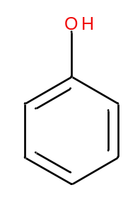
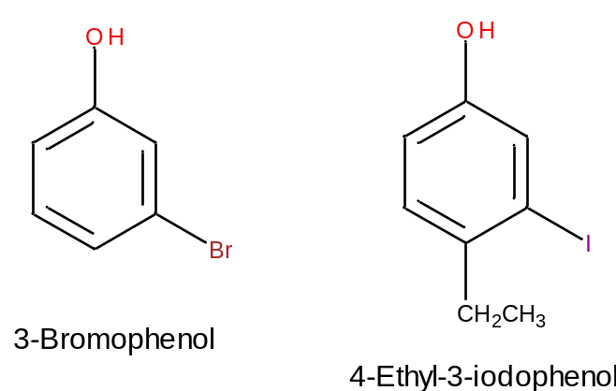
Structural characteristics of phenols
Phenols are aromatic compounds that bear a OH group.
This is another “special case” compound as far as IUPAC naming goes. Hydroxyl groups have higher priority than CH₃ groups (or others we’ve seen so far) for ring-numbering.
“phenol” = phenyl alcohol

Slide 35
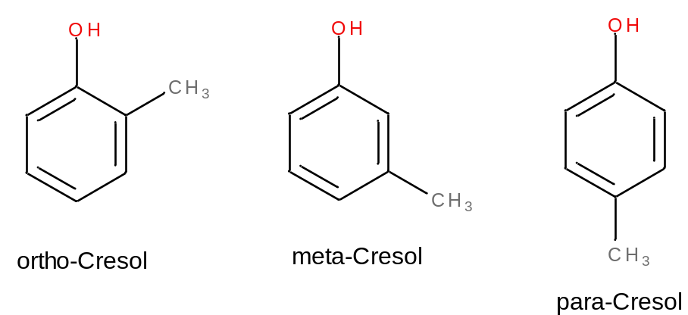
Structural characteristics of phenols
Benzenes that are substituted with both OH and CH₃ groups are called cresols (IUPAC-accepted common names):
For testing purposes, can also call these “methylphenols”

Slide 36
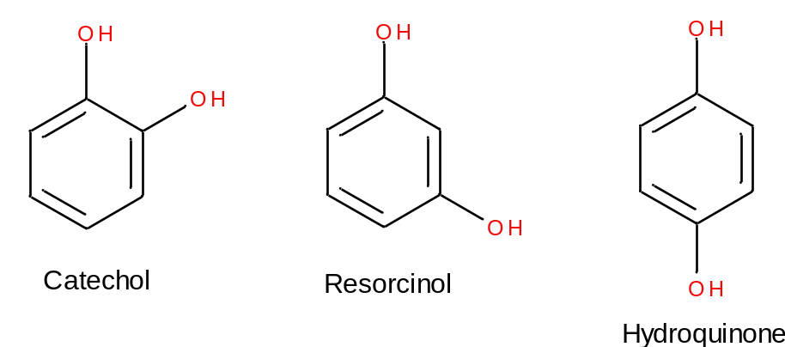
Structural characteristics of phenols
For dihidroxy-benzene structures, the following IUPAC-accepted common names are used:
Can also call these benzene diols (1,2-, 1,3-, 1,4-).

Slide 37
Physical and chemical properties of phenols
Alcohols and phenols are flammable.
Alcohols can be dehydrated, but not phenols
1º and 2º alcohols are oxidized by mild oxidizing agents. 3º alcohols and phenols do not undergo oxidation in these conditions.
Alcohols and phenols can undergo halogenation where the OH group is replaced by a halogen.

Slide 38
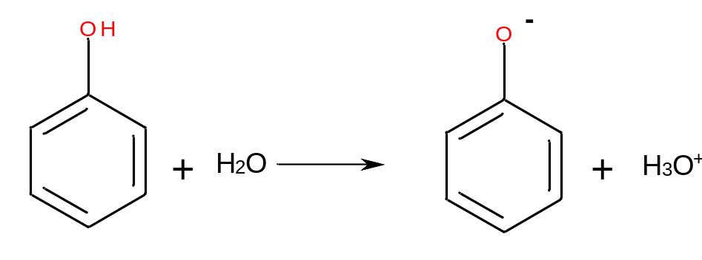
Physical and chemical properties of phenols
Phenols are weak acids in water. They undergo deprotonation, as discussed in Ch-10:

Slide 39
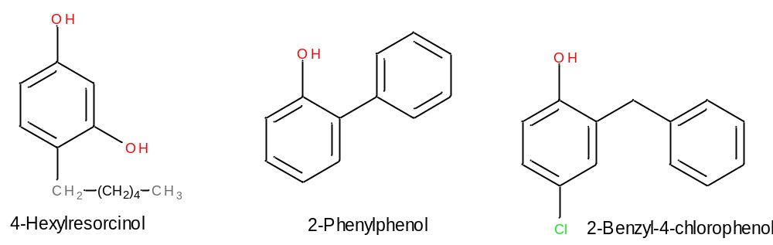
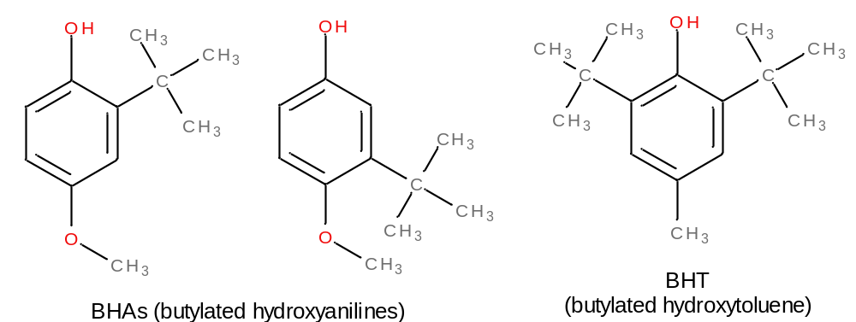
Occurrence and uses of phenols
an antiseptic
disinfectants
antioxidants

Slide 40
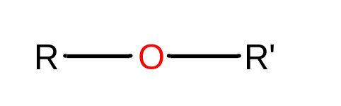
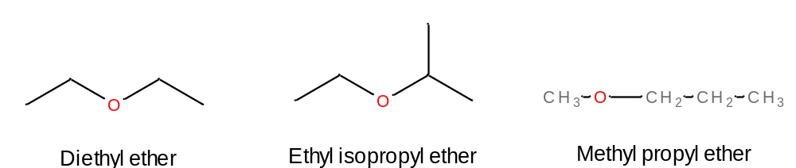
Nomenclature for ethers
Ethers are organic compounds in which two saturated carbon atoms are bound through a single oxygen atom.
Examples:
common names

Slide 41
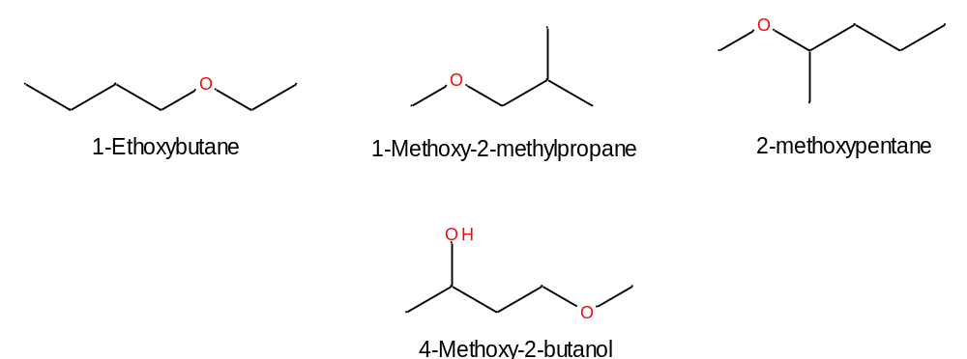
Nomenclature for ethers
The IUPAC system for naming ethers:
  Longest continuous carbon chain is used as parent name (might have substituents)
  Other chain is named as an alkoxy-substituent: change the “yl” part of the other alkyl chain to “oxy” (e.g. methyl to methoxy)
  Name as alkoxy name then the parent chain. Number the alkoxy substituent to indicate where it attaches to the parent alkane.
Alcohol group has higher priority

Slide 42
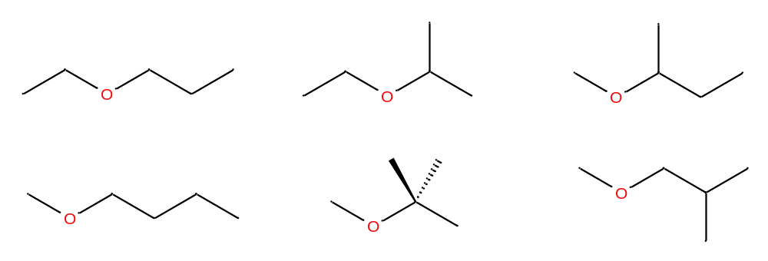
Isomerism in ethers
Because ethers contain C, H, and O atoms, the possibilities for isomers is greater than for hydrocarbons.
For example, an ether having two three carbon chains will have the following constitutional isomers:

Slide 43
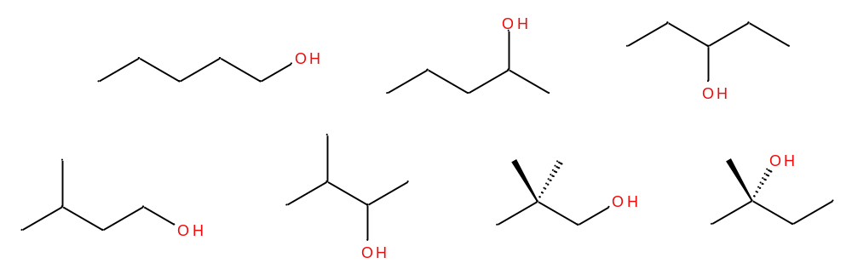
Isomerism in ethers
…and then the following functional group isomers (ethers have the same general formulas as alcohols).
Functional group isomers: constitutional isomers that contain different functional groups

Slide 44
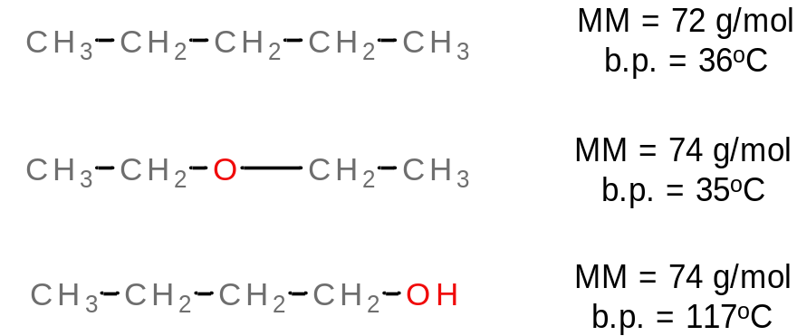
Physical and chemical properties of ethers
Boiling points and melting points are dictated by intermolecular forces. Compared with alkanes of similar molar mass, an ether will have a similar boiling point. Compared to an alcohol of the same molar mass, the ether will have a much lower boiling point.
Intermolecular force
London forces
London forces
London forces
+
H-bonding

Slide 45
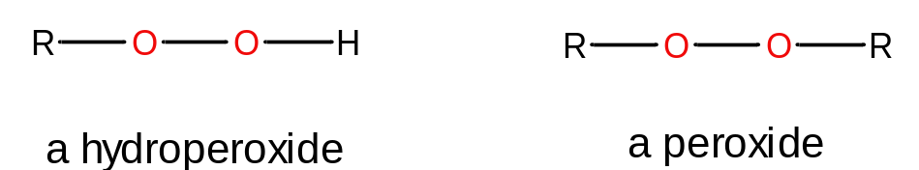
Physical and chemical properties of ethers
Ethers are more water-soluble than alkanes, because water molecules can H-bond with them.
An ether and an alcohol of the same molar mass have about the same solubility in water.
Some important chemical properties of ethers:
  Ethers are highly flammable. The b.p. of diethyl ether is 35ºC and ether vapor ignites readily.
  Ethers react with O₂ to form hydroperoxides and peroxides (unstable compounds which can explode)
  Otherwise, ethers react similar to alkanes in combustion and halogenation reactions.

Slide 46
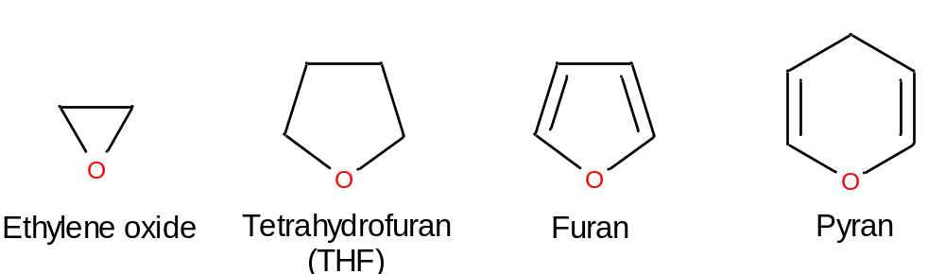
Cyclic ethers
Cyclic ethers are similar to cycloalkanes/cycloalkenes, but possess an O- atom as part of the ring.
Cyclic organic compounds in which one or more carbon atoms of the ring have been replaced by atoms of other elements are called heterocyclic organic compounds.

Slide 47
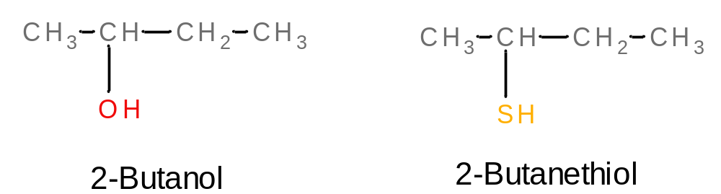
Sulfur analogs of alcohols
Thiols have the general formula R-SH. This is like an alcohol (R-OH), and both O and S are group 6 elements (and thus possess similar chemistry).
The –SH group of the thiol is called a sulfhydryl group.
Nomenclature: named similar to alcohols, but the ”ol” part of the becomes ”thiol”; also, the alkane part of the name becomes retained:

Slide 48
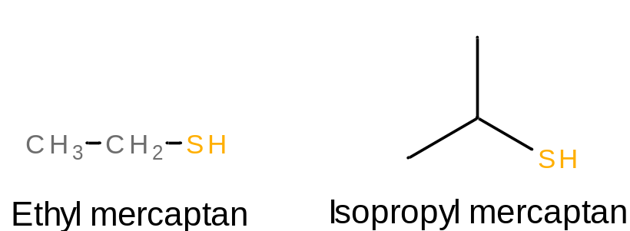
Sulfur analogs of alcohols
The common naming system for thiols involves use of the term “mercaptan”

Slide 49
Sulfur analogs of alcohols
In terms of properties and chemical reactions of thiols:
  They generally have lower boiling points than alcohols of similar structure (no H-bonding)
  They stink
Chemical reactions:
  Thiols are easily oxidized to form disulfides (important for protein chemistry)

Slide 50

Sulfur analogs of ethers
Thioethers are organic compounds in which two saturated carbon atoms are linked through a single sulfur atom.
The common naming system for thioethers is similar to that for ethers, with the name “ether” being replaced by “sulfide”
Common
IUPAC
Methylthiomethane
Methylthiobenzene
Methoxymethane
Methylthioethane
Replace “alkoxy” with “alkylthio” in IUPAC name

Slide 51

Sulfur analogs of ethers
In general, thioethers and thiols are more reactive than their ether and alcohol counterparts.
C-S bonds are weaker than C-O bonds
Functional group isomers are also a possibility for sulfur compounds

